Slide 1
Celebrating Scottish Research Conference Caitlin Astbury Research Communications Manager MS Society

Slide 2
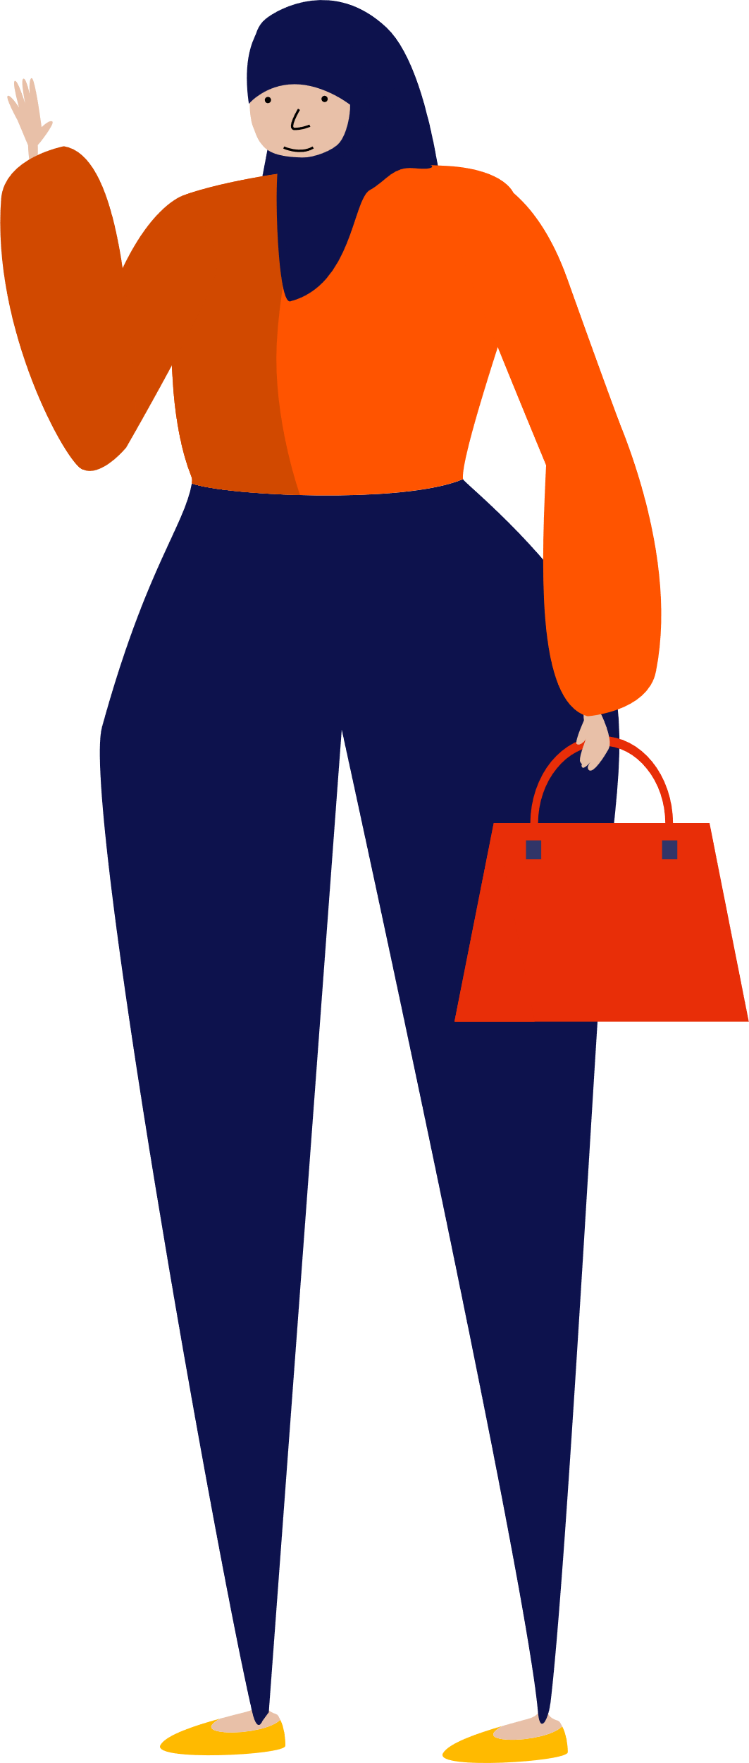
We’re the MS Society. We’re here for everyone with MS.
We fund world-leading research into ways to slow, stop and reverse disability progression
We provide reliable, accessible information resources
We fight for everyone in our community to get the support they need
We run bold campaigns to show the reality of life with MS
Notes:
A bit of background about who we are at the MS Society. We work across research funding, campaigning, information and support services to help people affected by MS across the UK. I’ll talk today about our research funding in Scotland.

Slide 3
How far have we come?
30 years ago
No treatments
1 gene linked with MS
Little understanding of environmental factors
Limited research on symptom relief
Today
Around 20 disease-modifying treatments, including 3 for progressive MS
Over 200 genes linked to MS
Better understanding of risk factors, including the role of EBV
New ways to manage symptoms like fatigue, spasticity and cognitive problems
Notes:
But first, think it’s good to reflect on how far we’ve come.

Slide 4
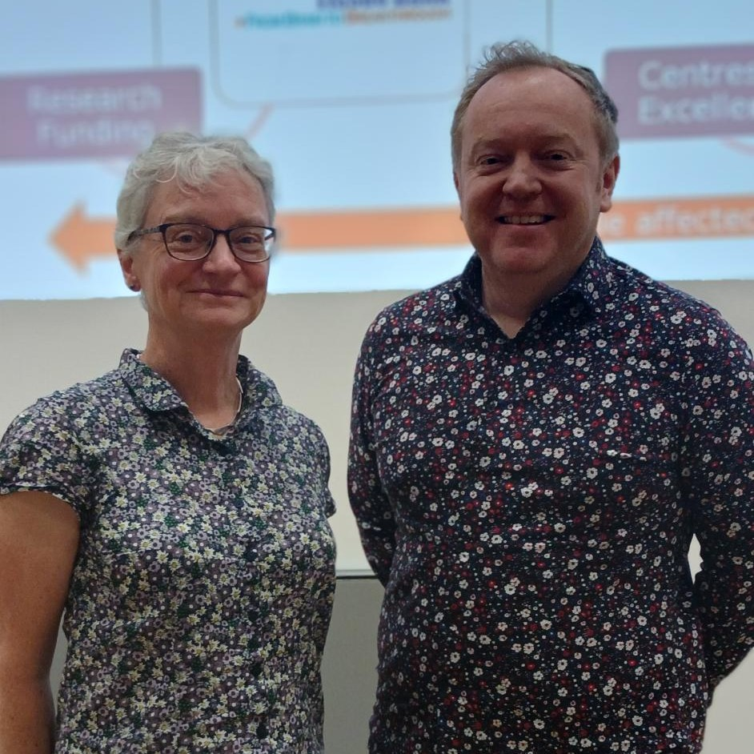
Our research funding in Scotland
MS Society Edinburgh Centre for MS Research
Focused on the biology of progressive MS, particularly neurodegeneration
Creating a drug discovery pipeline to screen drugs that may prevent neurodegeneration
Improving brain imaging, to better measure neurodegeneration and test the effectiveness of drugs in clinical trials
Professor Anna Williams and Professor David Lyons University of Edinburgh
Notes:
£1.85m

Slide 5
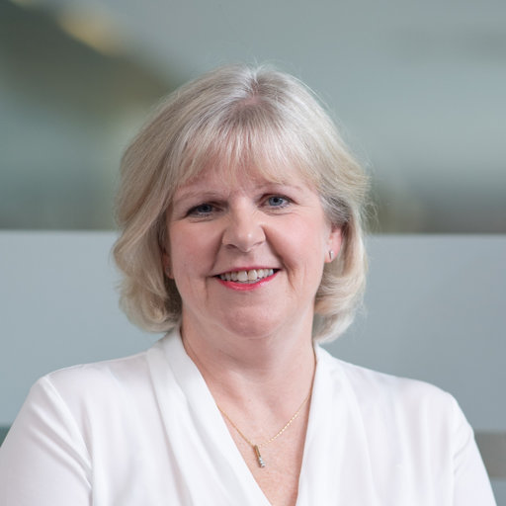
Our research funding in Scotland
Glasgow Caledonian University Doctoral Training Centre:
Training the next generation of symptom management researchers
Exercise and physical activity for people with moderate to severe MS
Professor Lorna Paul Glasgow Caledonian University
Notes:
The Doctoral Training Centre in Glasgow will research how exercise and physical activity can help people with moderate to severe MS to manage their MS. Train a group of 4 PhD students.
Both more traditional forms of exercise, but also new and innovative forms like dance and virtual reality. You can see in the screenshot here – researcher dancing with a person with MS. The researcher, Emily, was a professional ballerina with the Philadelphia ballet company. And is now working on a PhD in dance health.
The DTC will help fund more PhD students like Emily, to focus on impact of exercise for fatigue, mobility and cognition.
£430000 funding from us

Slide 6
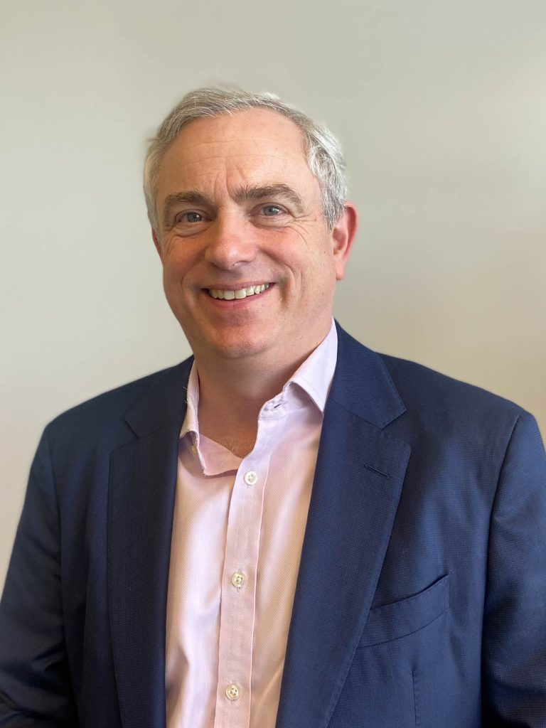
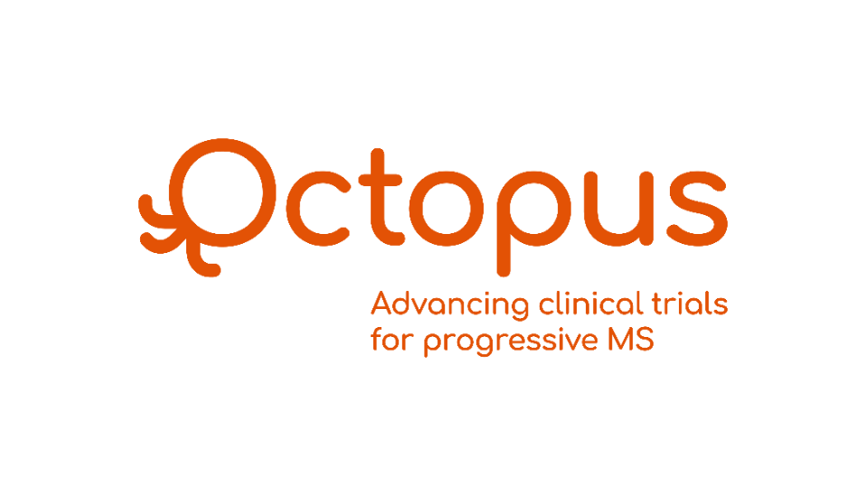
Our research funding in Scotland
Octopus
Multi-arm, multi-stage (MAMS) trial for people with primary and secondary progressive MS
Professor Jeremy Chataway University College London
Notes:
For many years our ambition has been to set up a progressive MS ‘mega-trial’ that will test repurposed drugs more efficiently than the standard process.
This is a trial for primary and secondary progressive MS, and the aim is to test potential treatments for MS more quickly and cheaply.
Being led by Prof Jeremy Chataway from UCL – but with sites across the UK, including Edinburgh. You’ll now have the opportunity to hear from Octopus PI in Edinburgh, Dr Peter Foley.

